Slide 1

Airline Travel Safety Executive Summary
By Bryce Kirby

Slide 2
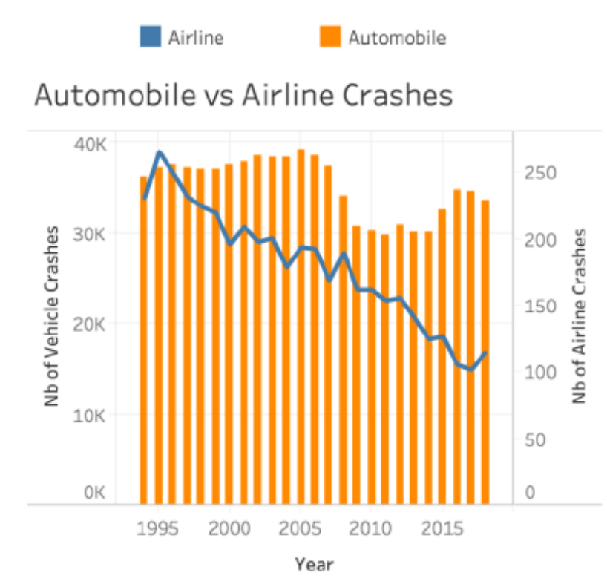
Car Accidents Verses Plane Accidents
It is a fact of life that car accidents as well as plane accidents occur
It is also a fact that from 1985 to current, these accidents have increased in number due to the increase in automobiles and planes and their demand
As seen in the graphs, it can be determined that the number of airline industry accidents have reduced over the span of time, while the number of crashes in automobiles have remained overall constant with some lows and highs.

Slide 3
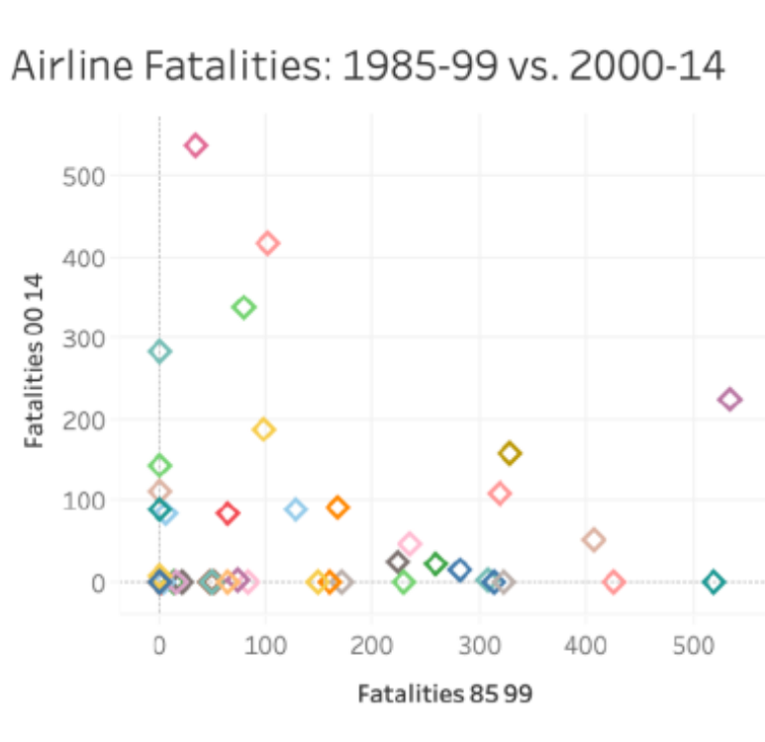
Airline Incidents With Fatalities
When comparing Airline Incidents that resulted in fatalities for the years 1985-1995 versus 2000-2014, the incidents reduced by almost fifty percent.
The graph shows that it was safer to travel in 2000-2014

Slide 4
Airlines with Most Fatalities
Looking at individual airlines and the incidents with fatalities, the graph shows which airlines had the most is Aeroflot
Although the goal is to have zero incidents and zero fatal incidents, comparing the two ranges 1985-1999 versus 2000-2014, the graph shows a drastic improvement preventing fatalities in the incidents that occurred

Slide 5
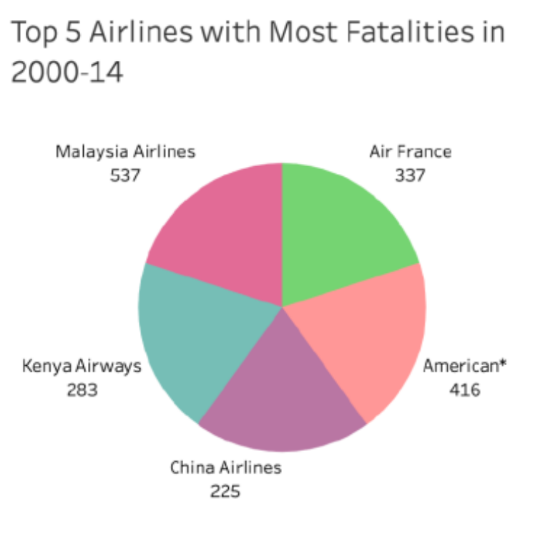
Airlines with The Most Fatalities in 2000-2014
Through the years, the airline industry has developed better safety practices and are better equipped to handle emergencies and incidents
During the years of 2000-2014 there were still incidents with fatalities, the graph show the top five airlines that had the most numbers of incidents with fatalities
The top two airlines that seem to have the most fatal incidents are Malaysia Airlines and American Airlines
A clear indication that throughout the airline industry there still needs to be improvement to bring those numbers down much more

Slide 6
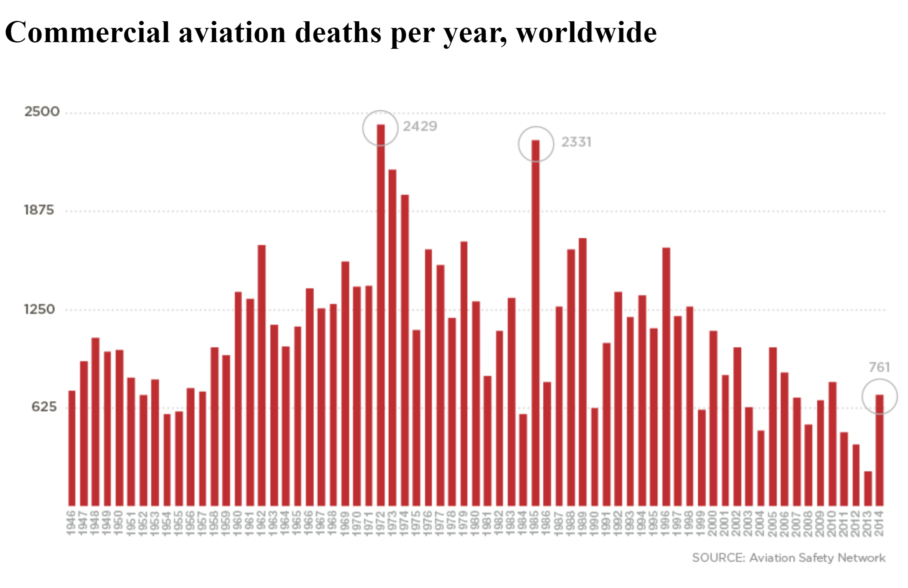
Airline Fatalities: Worldwide
Looking at the graph for airline incidents that resulted in fatalities worldwide, 1985 was the biggest when looking at 1985-1999 versus 2000-2014
Looking at this is showing the improvements made in safety and emergency preparedness to lessen the numbers over time
Even with improvements there are still years that levels rose

Slide 7
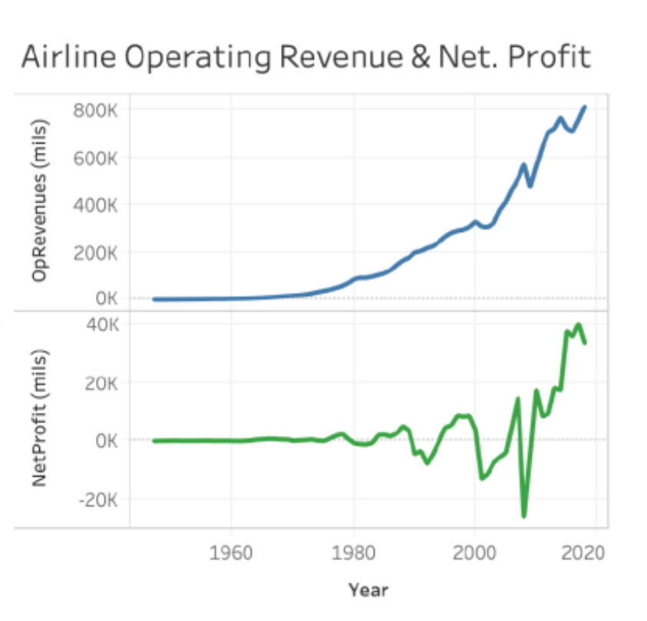
Airline Operating Revenue
Regardless of the incidents that airlines have suffered that lead to fatalities, their revenue continues to grow
Like all industries and businesses operating expenses with growth will always grow were as the profits doe have their low points although it is a contestant growth due to demand for airline transportation
It shows that no matter the airline industries with its bumps and incidents will always have a consistent profit due to high demand for air travel

Slide 8
References
Administration, N. H. T. S. (n.d.). Fars Encyclopedia. FARS Encyclopedia: Trends - General. https://www-fars.nhtsa.dot.gov/Trends/TrendsGeneral.aspx
Cable News Network. (n.d.). Commercial aviation deaths per year, worldwide. CNN. https://www.cnn.com/interactive/2014/07/travel/aviation-data/
Peng, V. (2022, October 22). How safe is air travel? (aviation crash statistics 1985-2014). Information Visualization. https://studentwork.prattsi.org/infovis/visualization/how-safe-is-air-travel-aviation-crash-statistics-1985-2014/
Statistics. Bureau of Aircraft Accidents Archives. (n.d.). https://www.baaa-acro.com/statistics

